Slide 1
Food Filter
Project

Slide 2
Childhood OBESITY IN AMERICA
PROBLEM STATEMENT
For parents of children at home, it’s a constant challenge to make sure their children are eating right. Day and day out, these parents work hard to make sure their families are living healthy lifestyles.
A huge problem many of these parents face is knowing which foods are healthy/unhealthy options for their families. Today, there is no one best solution for every parent and family and the growing childhood obesity epidemic in the US suggests a lack of viable and sustainable options for this enormous problem. According to The Partnership for a Healthier America, children with obesity have three times more healthcare expenditures than children at healthy weights, costing an estimated $14 billion every year. If this trend continues, future generations will be even more plagued with issues in adulthood associated with childhood obesity, such as heart disease, type 2 diabetes, and cancer.

Slide 3
Childhood OBESITY IN AMERICA
PROBLEM STATEMENT
If only there were a better way to help address the main factors contributing to childhood obesity—as the Mayo Clinic puts it, “Lifestyle issues—too little activity and too many calories from food and drinks”, parents could proactively promote a healthier lifestyle, leading to a higher quality of life for their children both now and in the future. At a prevalence of 18.5%, obesity affects almost 14 million children and adolescents in the US, and nearly one in three are considered either have obesity or are overweight. With this number having risen ten-fold over the past four decades, there is a clear opportunity to empower millions of people and their families to lead better lives.

Slide 4
Childhood OBESITY IN AMERICA
BACKGROUND
Obesity is defined as a body mass index (BMI) at or above the 95th percentile of the CDC sex-specific BMI-for-age growth charts. Relatedly, the term overweight is defined as having a BMI in the 85th to 94th percentiles.¹
The National Survey of Children’s Health estimated that, in 2017-2018, approximately 18.5% (over 10 million) of the youth (between the ages of 2 and 19) in the United States were considered obese. If you include overweight children, that number rises to 1 in 3 (about 18 million) of our youth in the US who are obese or overweight.²
According to the NIH, the prevalence of overweight is higher in African American and Hispanic children compared to non-Hispanic white children. Approximately 35.9 percent of African American children ages 2–19 years are overweight or obese, compared to 29.3 percent of white children of the same age that fall in either category. 1 are considered overweight. By contrast, 38.2 percent of Hispanic children (including Mexican Americans) ages 2–19 years are overweight or obese.³
¹ Source: https://www.cdc.gov/obesity/childhood/defining.html
² Source: https://stateofchildhoodobesity.org/data/
³ Source: https://www.cdc.gov/nchs/data/hestat/obesity_child_13_14/obesity_child_13_14.htm

Slide 5
Childhood OBESITY IN AMERICA
BACKGROUND
National Collaborative on Childhood Obesity Research (NCCOR) has said:
Childhood obesity alone is estimated to cost $14 billion annually in direct health expenses, and children covered by Medicaid [read: children of poorer families] are nearly six times more likely to be treated for a diagnosis of obesity than children covered by private insurance.¹
¹ Source: https://www.nccor.org/downloads/ChildhoodObesity_020509.pdf

Slide 6
Childhood OBESITY IN AMERICA
BACKGROUND
Here are some more facts to chew on childhood obesity’s effects. According to health.gov¹:
Long-term, serious health concerns can develop from being obese as a child; among these medical conditions are bone and joint problems, type II diabetes, asthma, heart disease, cancer, high blood pressure, and asthma.
The effects of early obesity can be more than just physical; early studies indicate that low self-esteem due to childhood obesity likely has negative effects on academic performance and social interactions.
Research shows obesity in childhood can be tied to obesity later in life; obese children and adolescents are more likely to become obese as adults compared to non-obese children.
It’s a growing (pun-intended) problem in our country; between 1985 and 2015, the rate of prevalence of obesity in children tripled.
¹ Source: https://health.gov/news/blog/2015/02/lets-move-to-end-childhood-obesity/

Slide 7
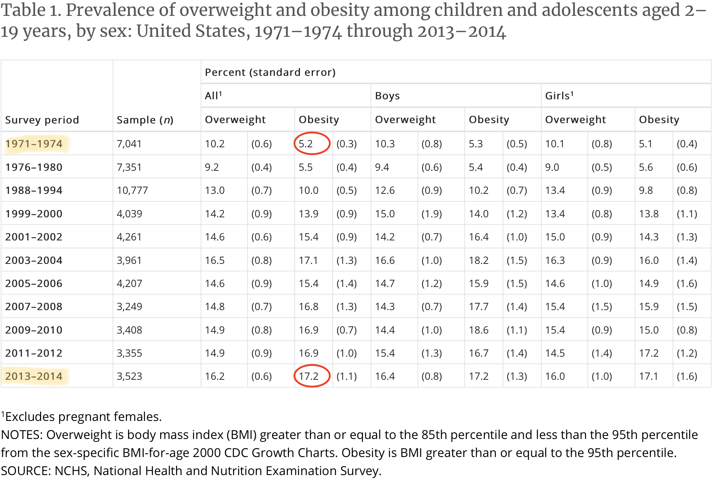
Childhood OBESITY IN AMERICA
BACKGROUND
Source: https://www.cdc.gov/nchs/data/hestat/obesity_child_13_14/obesity_child_13_14.htm

Slide 8
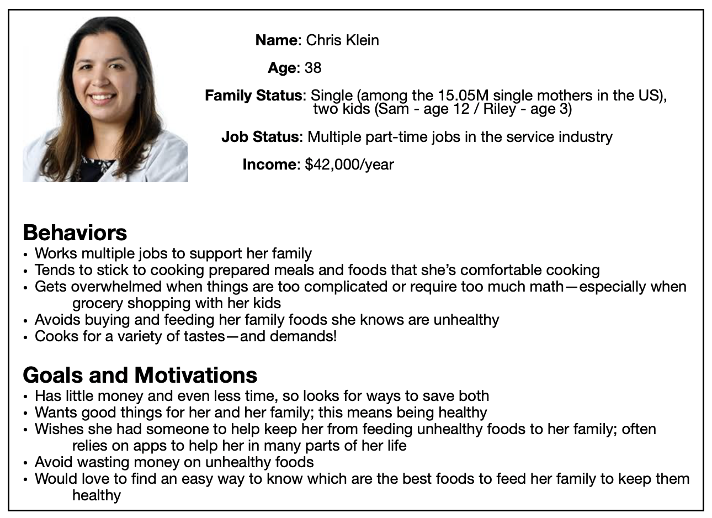
Childhood OBESITY IN AMERICA
Persona

Slide 9
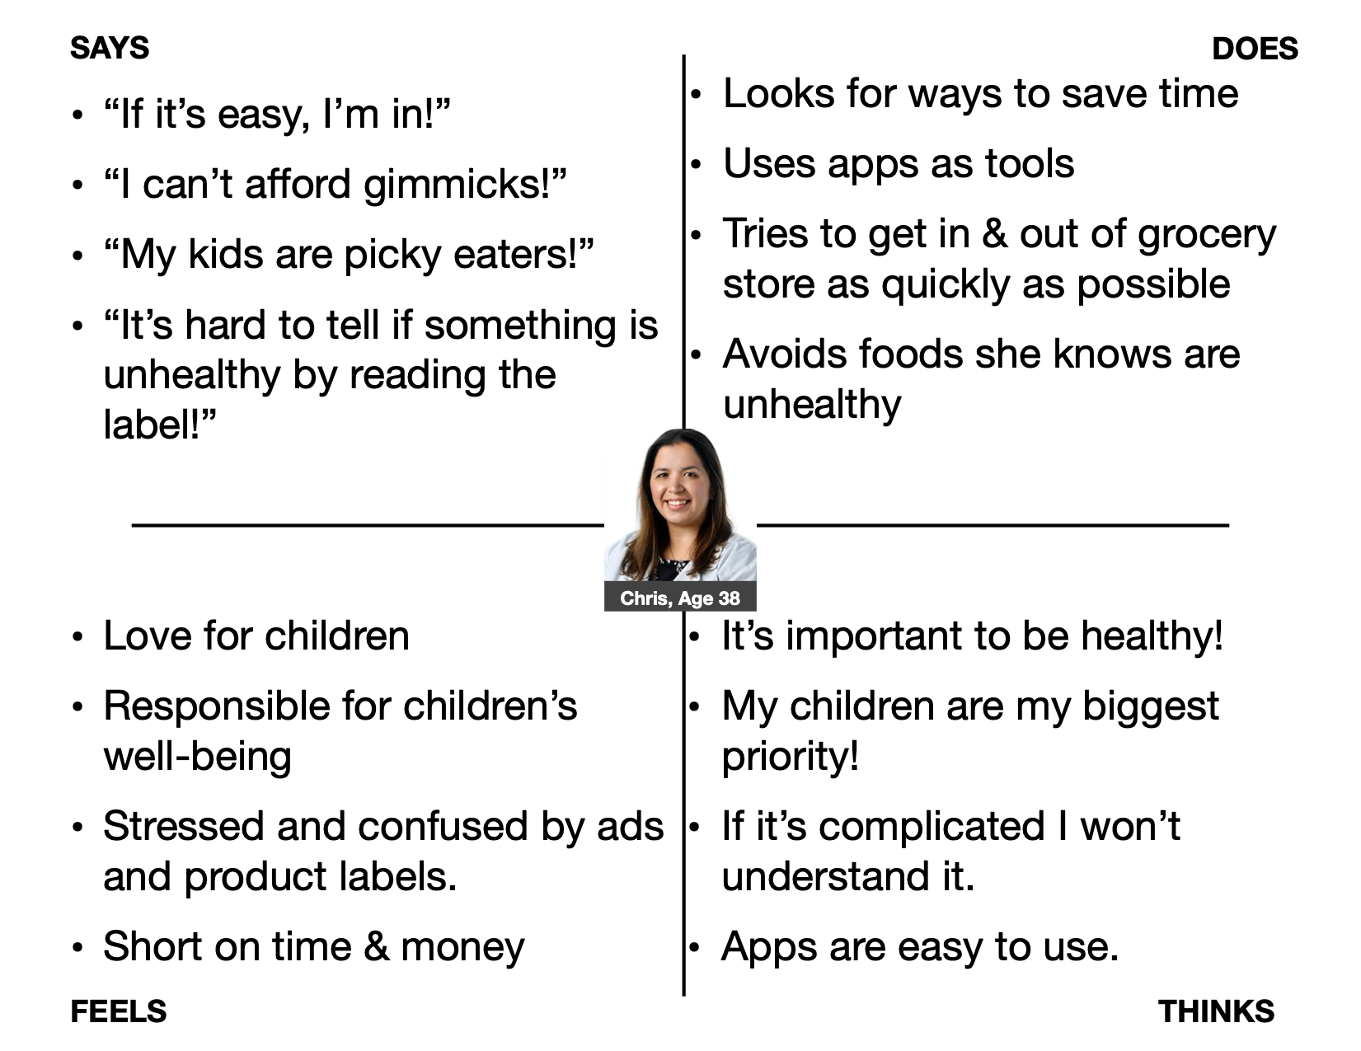
Childhood OBESITY IN AMERICA
CHRIS’ EMPATHY map

Slide 10
Childhood OBESITY IN AMERICA
current state journey map

Slide 11
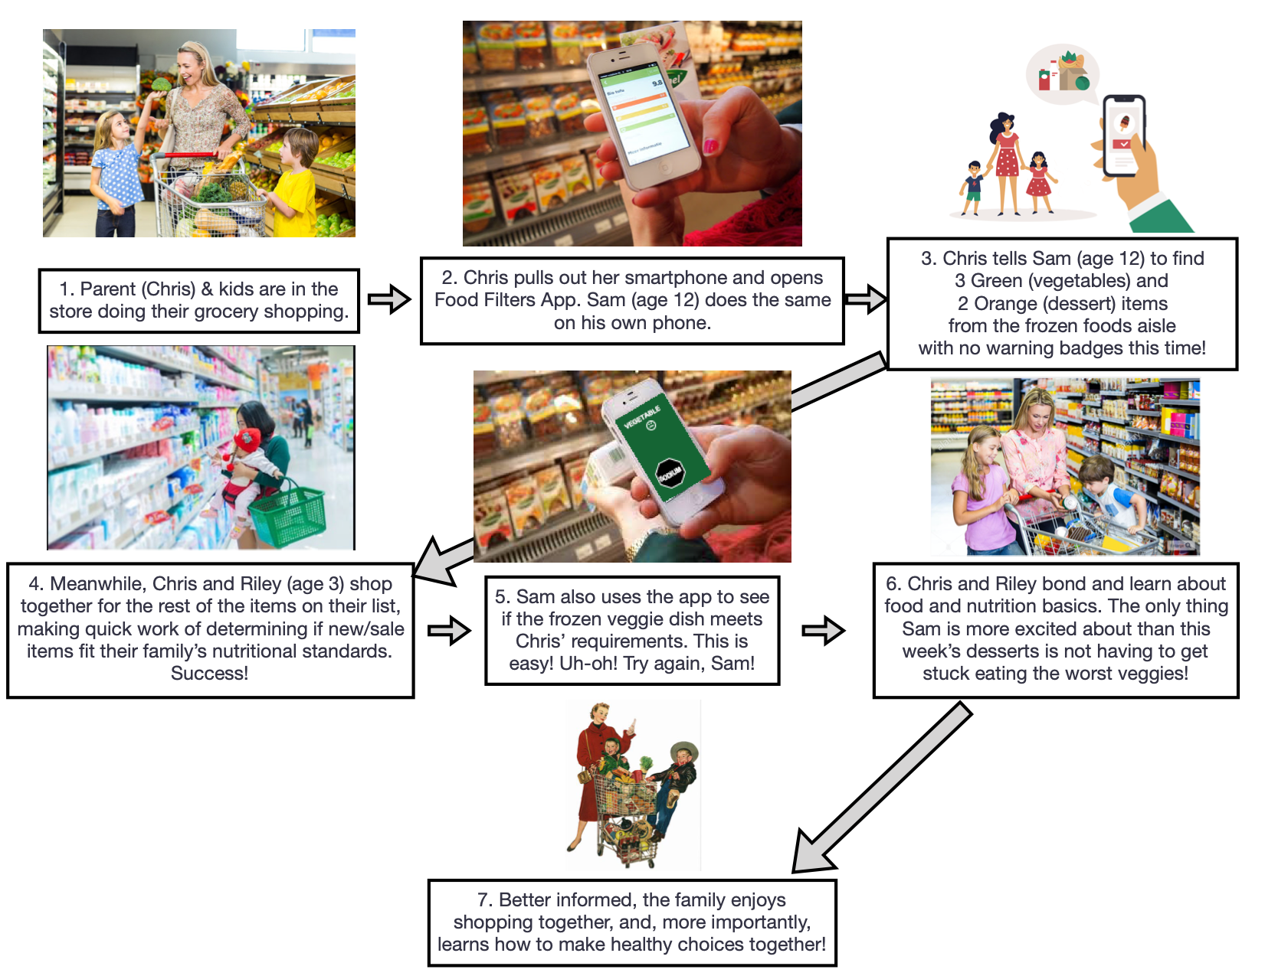
Childhood OBESITY IN AMERICA
FUTURE STATE journey map

Slide 12
Childhood OBESITY IN AMERICA
SOLUTION
Proposed Solution:
A tool to help parents quickly and easily identify important nutritional information when grocery shopping for their families in order to help feed their families healthier food and, in the process, fight childhood obesity.

Slide 13
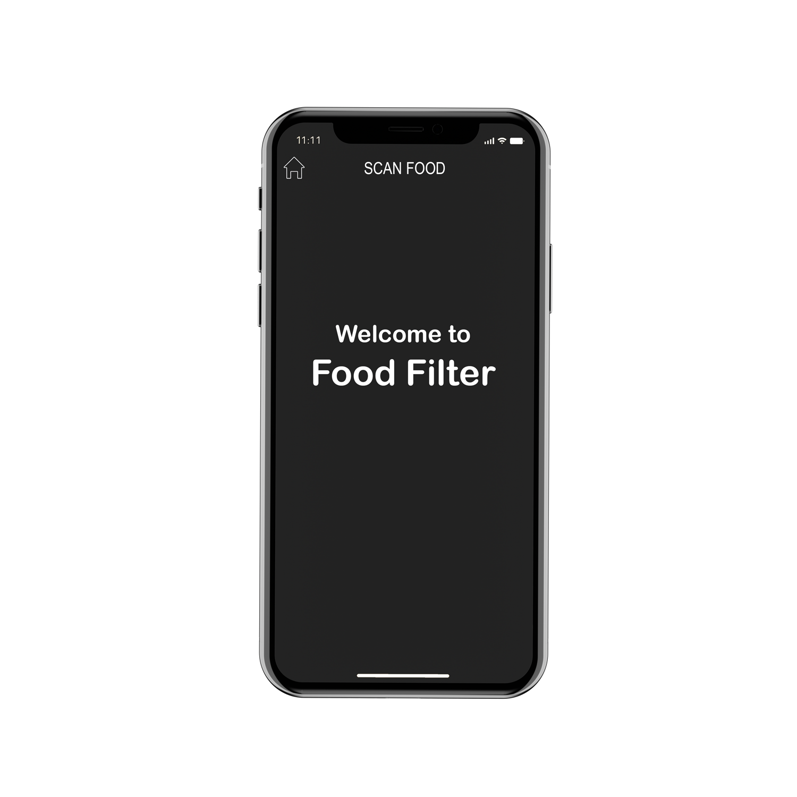
Childhood OBESITY IN AMERICA
SOLUTION
Proposed Solution:
A tool to help parents quickly and easily identify important nutritional information when grocery shopping for their families in order to help feed their families healthier food and, in the process, fight childhood obesity.

Slide 14
Childhood OBESITY IN AMERICA
FOOD FILTER PROJECT
You’re probably wondering what Food Filter is. I figured you’d be.

Slide 15
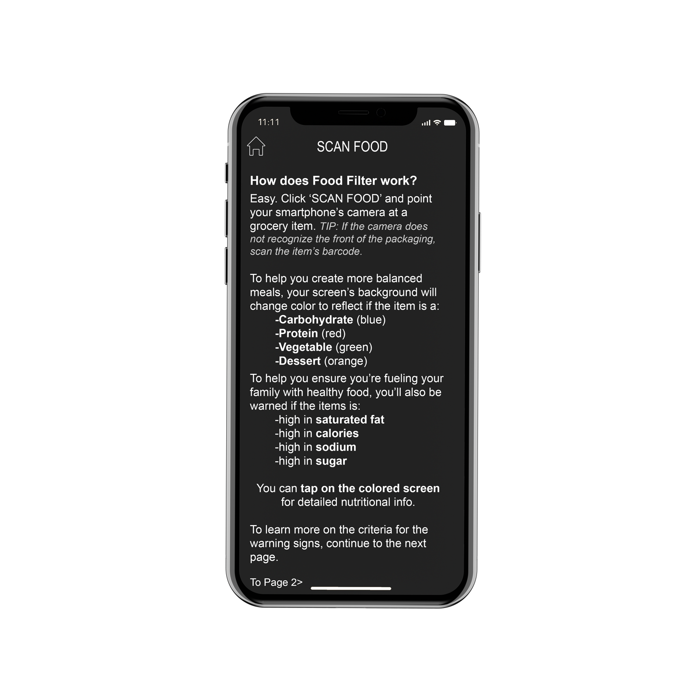
Childhood OBESITY IN AMERICA
FOOD FILTER PROJECT
You’re probably wondering what Food Filter is. I figured you’d be.
That’s why users are taken to this screen after the Welcome Screen has loaded or when you hit the home button.

Slide 16
Childhood OBESITY IN AMERICA
FOOD FILTER PROJECT
How does Food Filter work?
It’s easy. You click ‘SCAN FOOD’ and point your smartphone’s camera at a grocery item.
What’s going on behind the scenes?
The camera is using image-recognition to identify the products and pull their nutritional information. If, however, the item is not recognized from the front of the packaging, customers can scan the item’s barcode, accessing a much larger product database.

Slide 17
Childhood OBESITY IN AMERICA
FOOD FILTER PROJECT
How does Food Filter work?
To help users create more balanced meals, their screens' background will change color to reflect if the item scanned is a Carbohydrate (blue), Protein (red), Vegetable (green), or Dessert (orange).
What’s going on behind the scenes?
Once Food Filter has pulled the item’s nutritional information, it is then identified as being primarily one of the groups above based on established classifications—or on a complex calculation, for new products until they can be classified—developed by our certified nutritionists.

Slide 18
Childhood OBESITY IN AMERICA
FOOD FILTER PROJECT
How does Food Filter work?
To help you ensure you’re fueling your family with healthy food, you’ll also be warned if the items is high in Saturated Fat, Calories, Sodium, and Sugar.
You can also tap on the results screen to see detailed nutritional info.
What’s going on behind the scenes?
Same as before, once Food Filter has pulled the item’s nutritional information, it runs the info through some predetermined calculations and identifies the food as being high in one or more of the groups above.

Slide 19
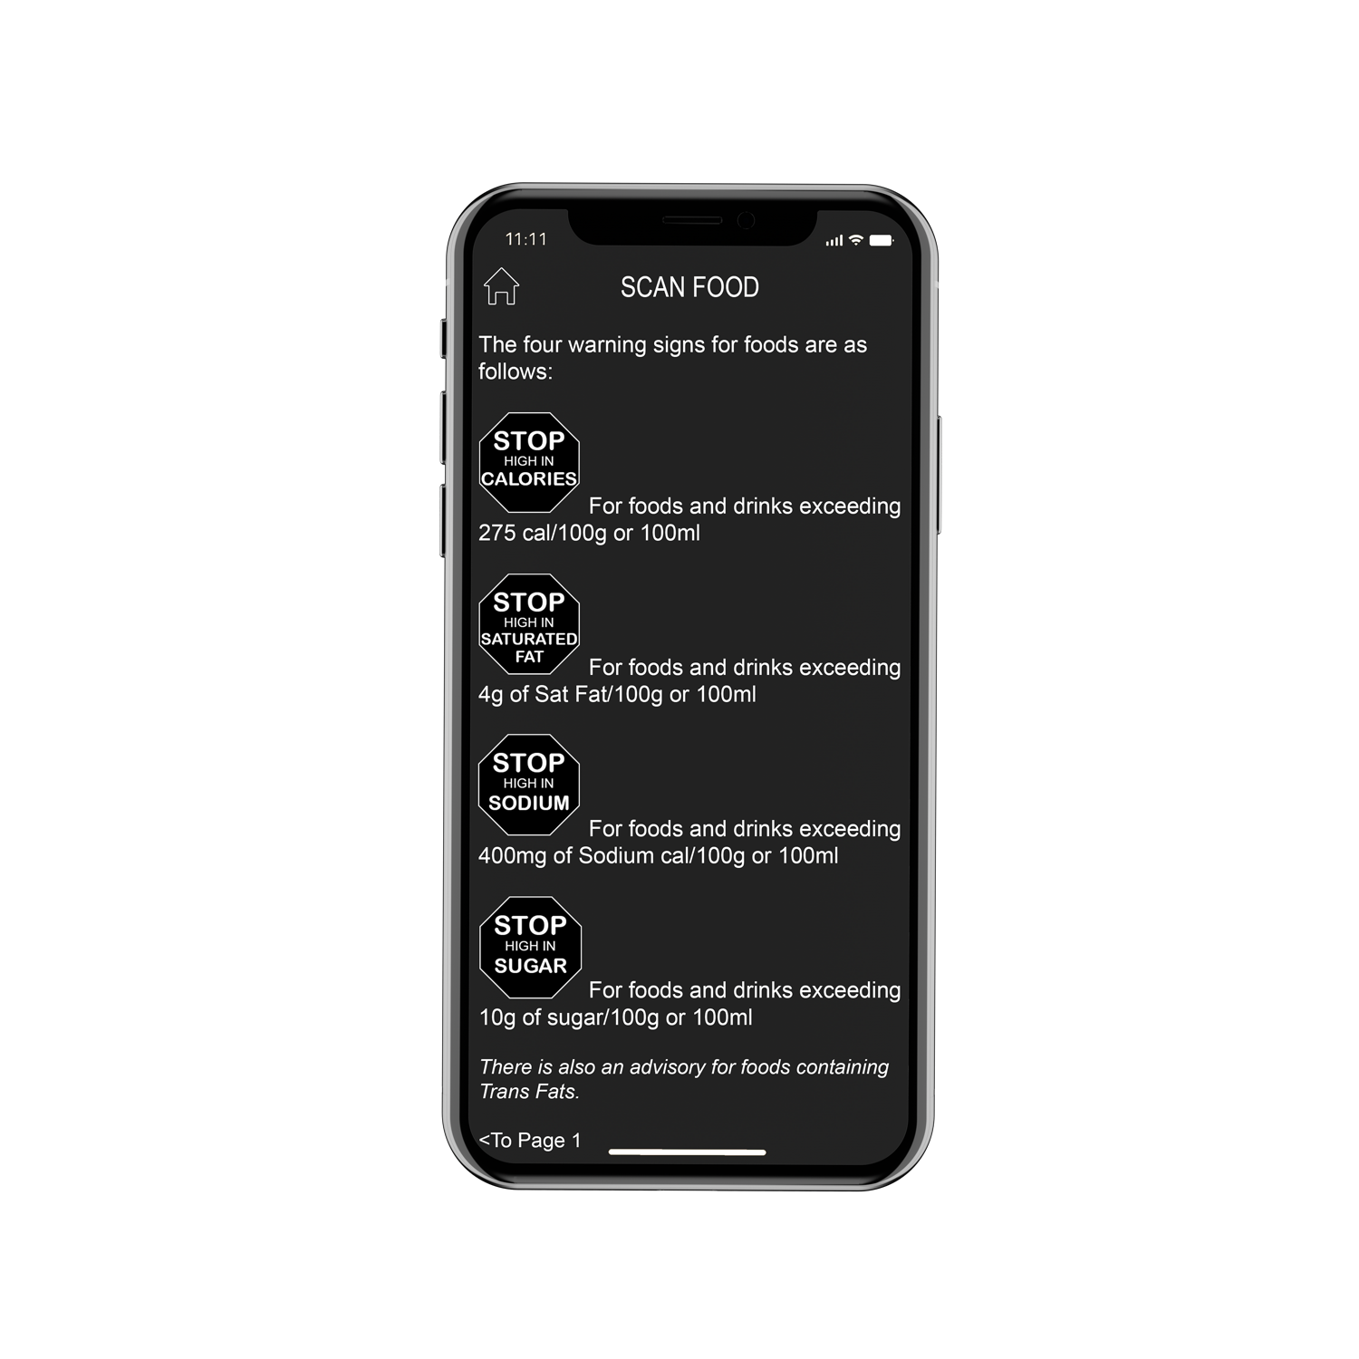
Childhood OBESITY IN AMERICA
FOOD FILTER PROJECT
How does Food Filter work?
Here’s what appears on a user’s screen when a product is high in Calories, Saturated Fat, Sodium, and/or Sugar.
What’s going on behind the scenes?
The classifications are determined by using guidelines established by the Chilean government on a similar project implemented in 2016, which was an inspiration for this project. The STOP signs appear when foods exceed, per 100 grams: 275 calories, 400 mg of sodium, 10 g of sugar, or 4 g of saturated fats.
Also, if a product’s nutritional info says it contains Trans Fats, the user will be shown an advisory.

Slide 20
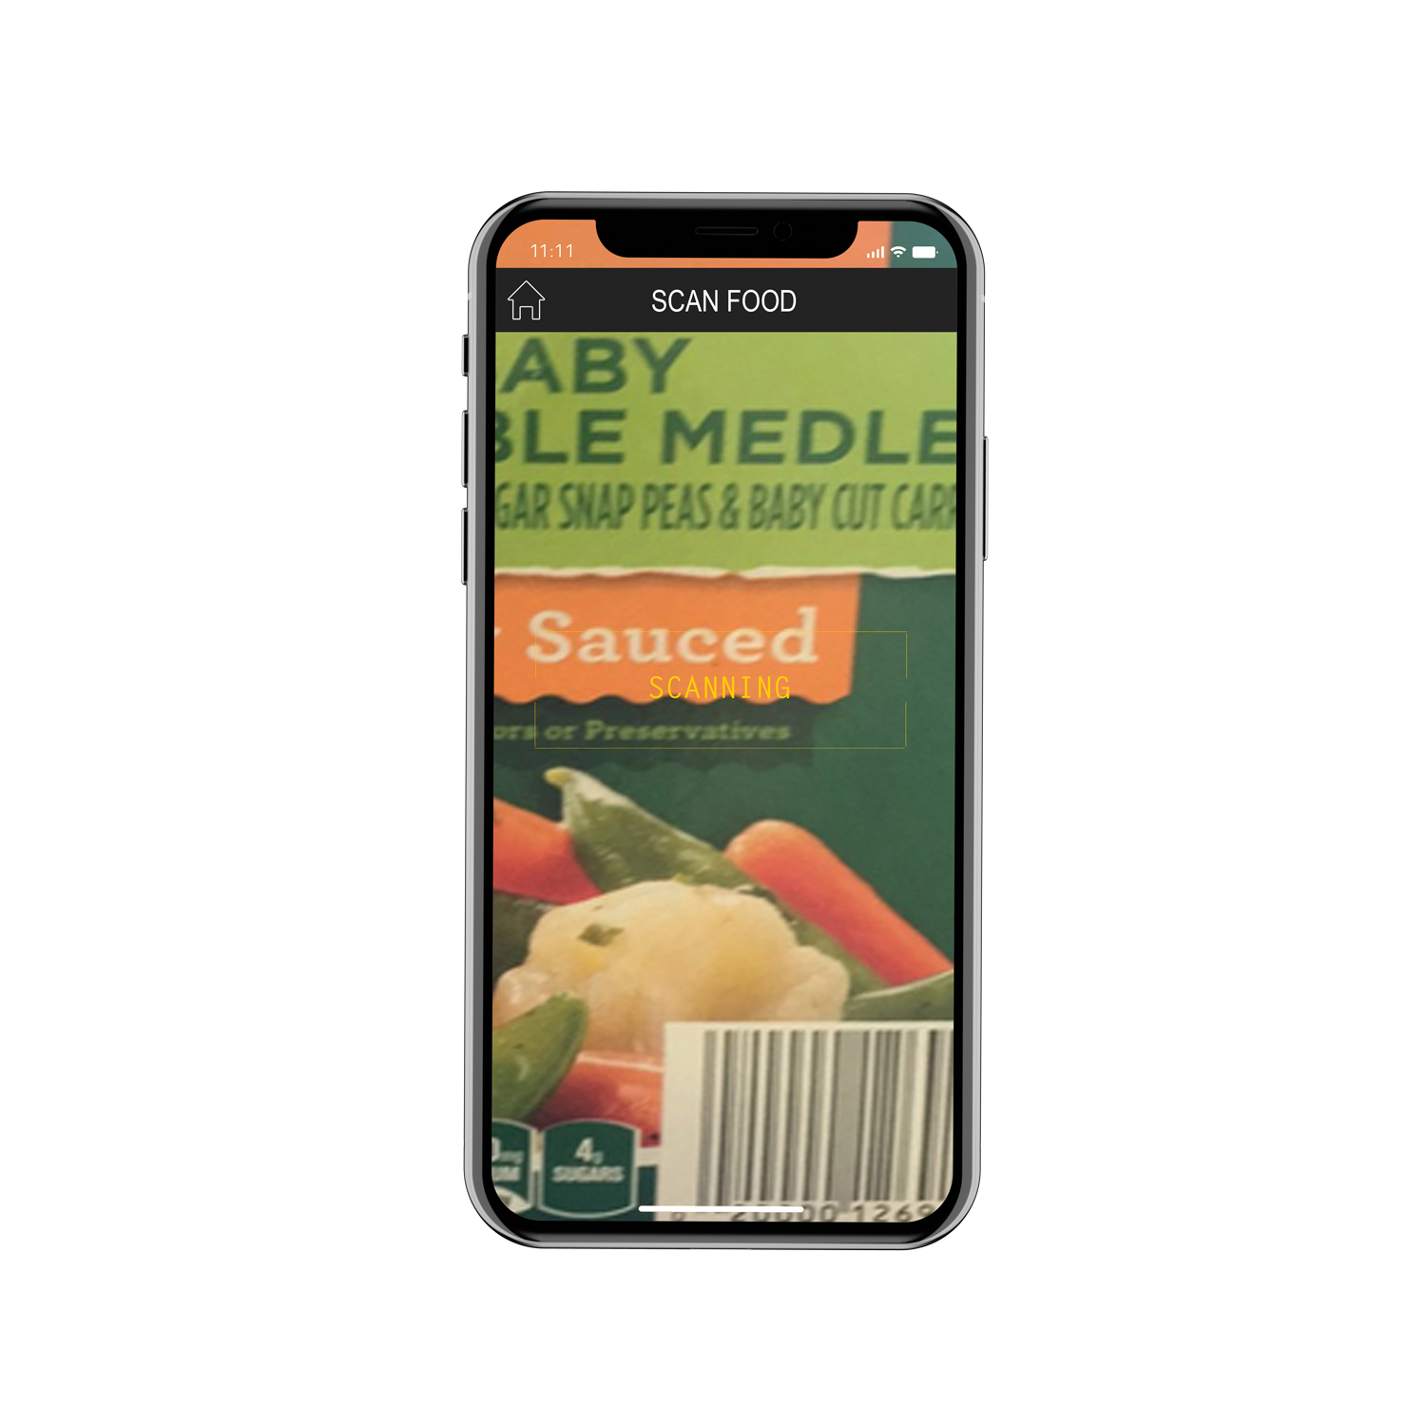
Childhood OBESITY IN AMERICA
FOOD FILTER PROJECT
How does Food Filter work?
When you tap SCAN FOOD, your camera will open and you’ll be able to scan an item.

Slide 21
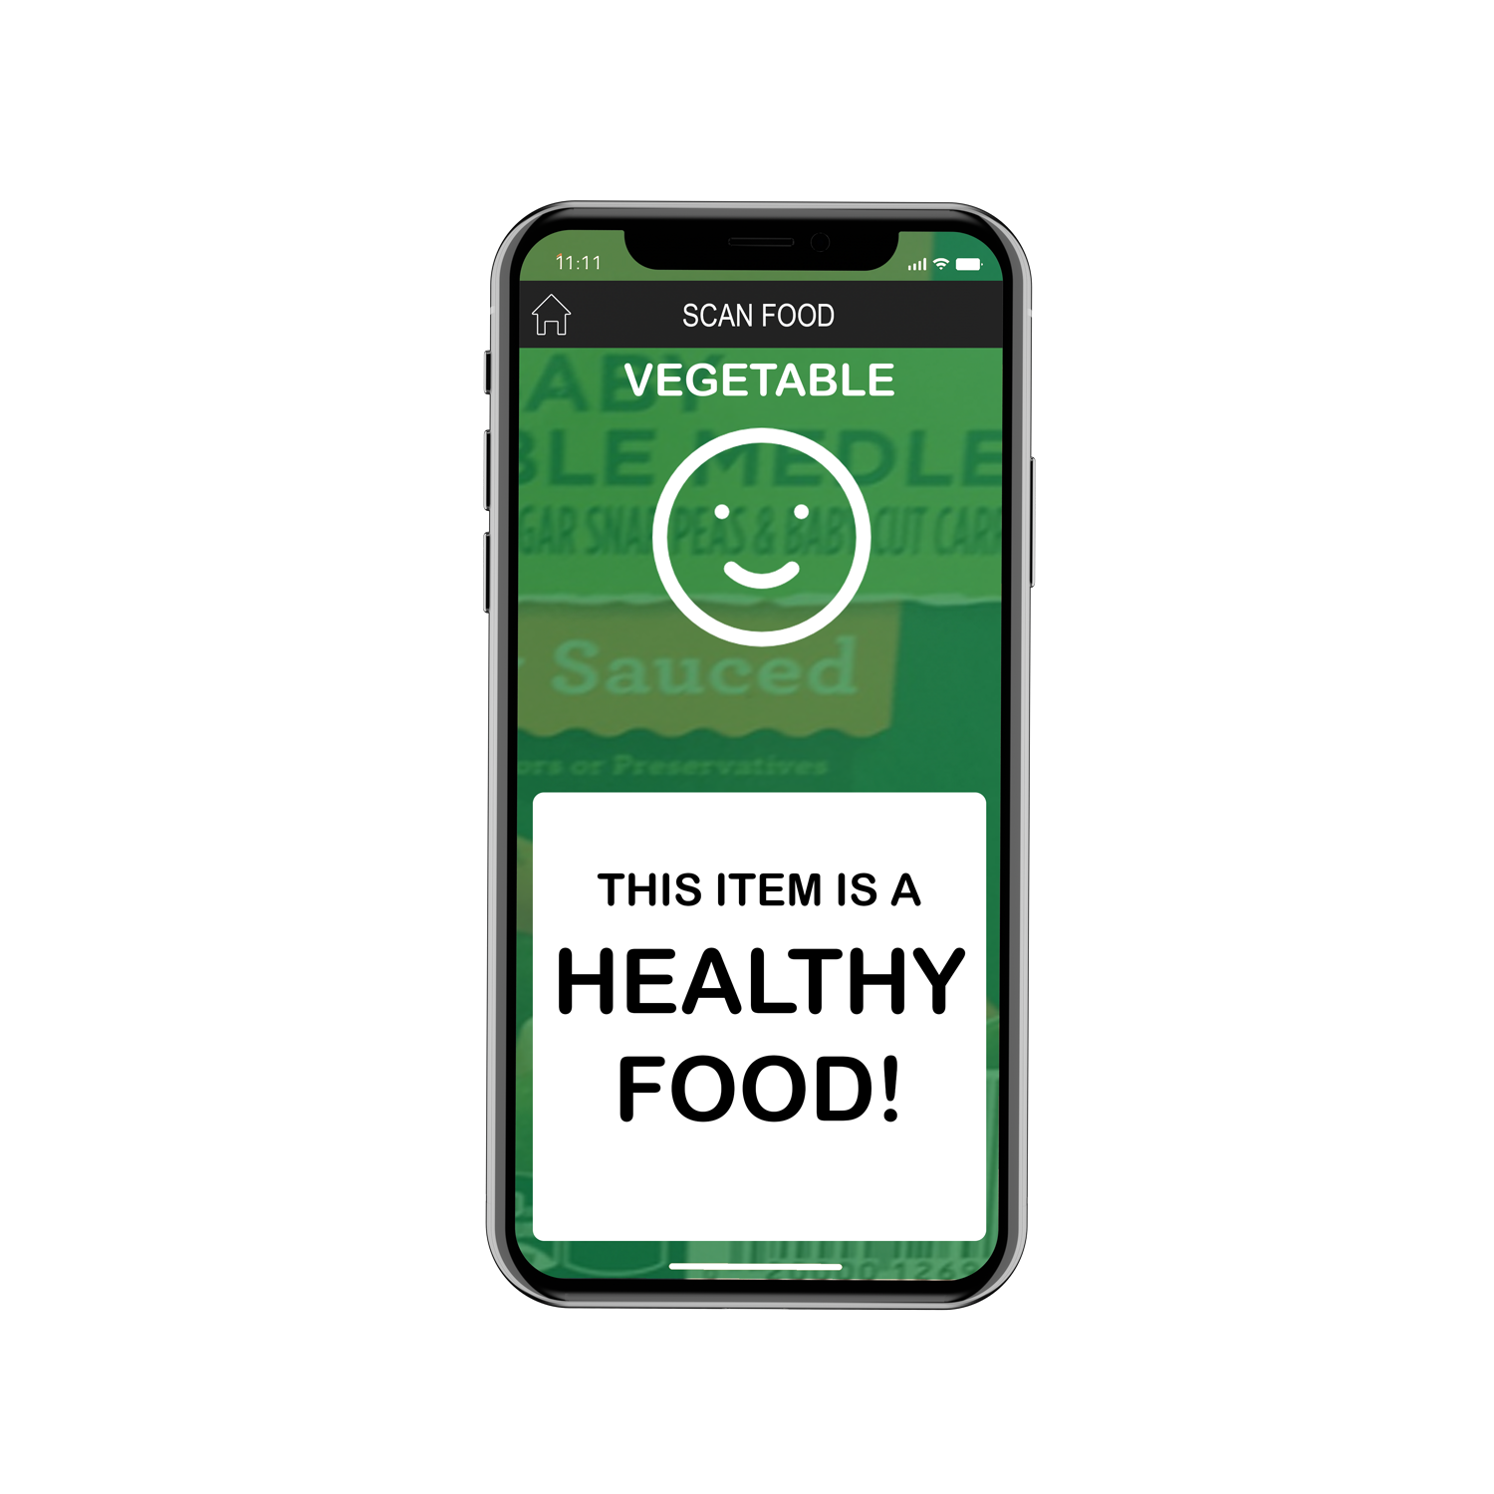
Childhood OBESITY IN AMERICA
FOOD FILTER PROJECT
How does Food Filter work?
Once Food Filter determines which product the user is scanning, it will identify the type of food the item is (here it’s VEGETABLE) and whether or not there are any excess STOP sign warnings.

Slide 22
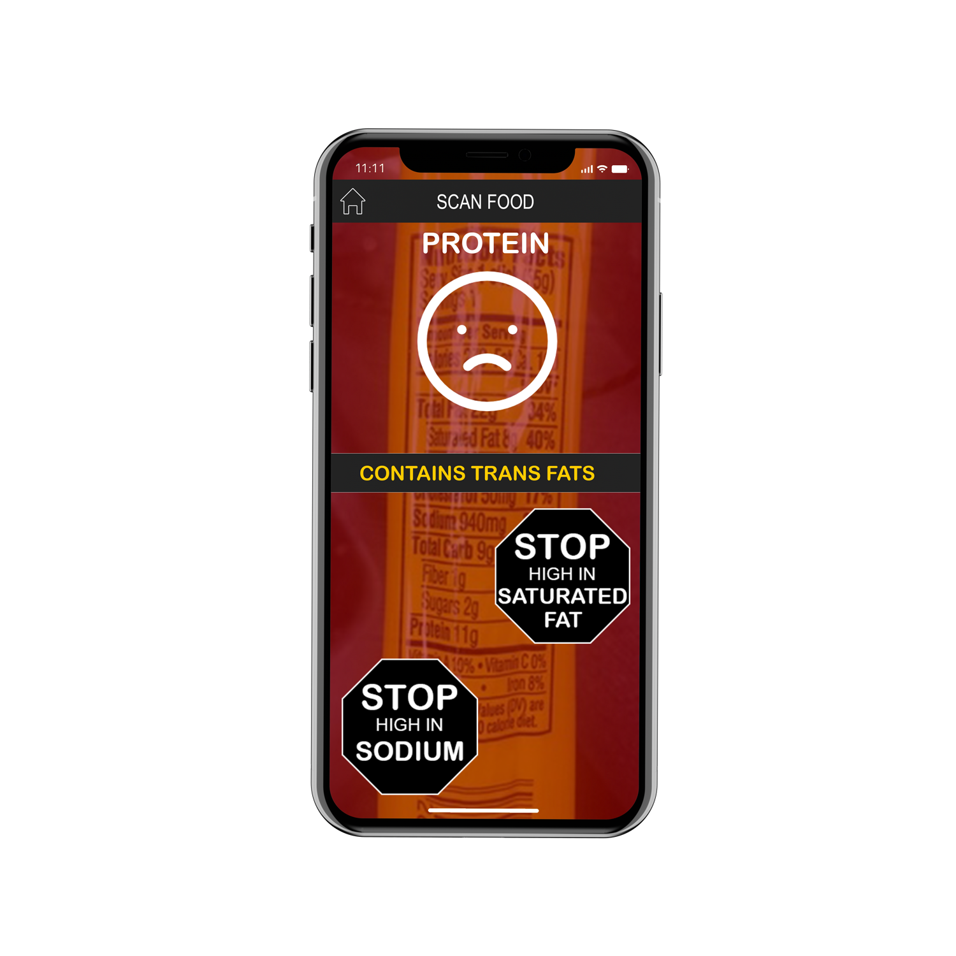
Childhood OBESITY IN AMERICA
FOOD FILTER PROJECT
How does Food Filter work?
Let’s look at another item. This was a Slim Jim.
Let’s tap on the screen for nutritional information.

Slide 23
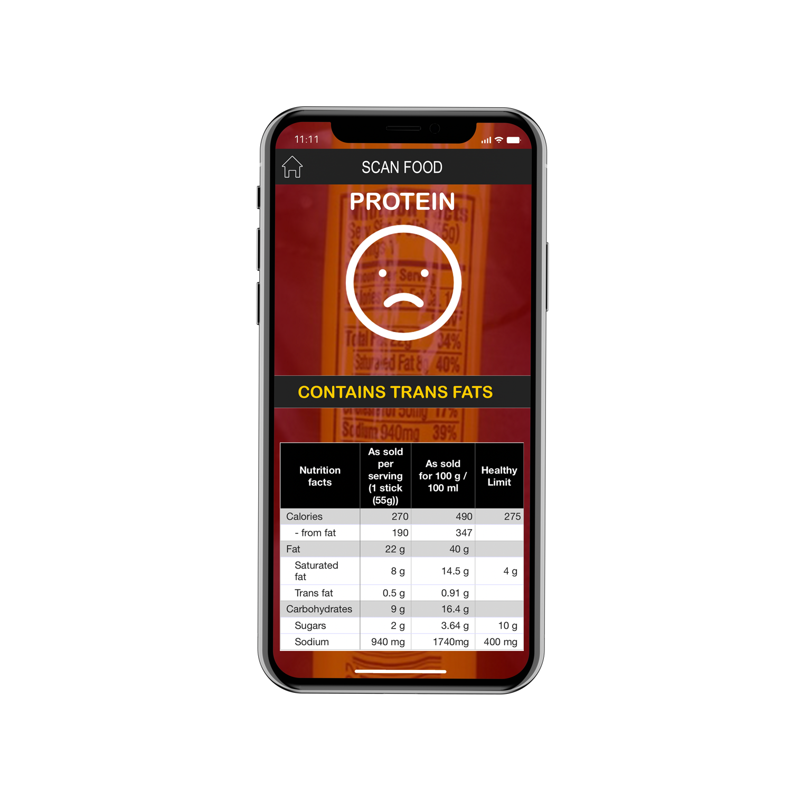
Childhood OBESITY IN AMERICA
FOOD FILTER PROJECT
How does Food Filter work?
The nutritional information isolates the key components’ values for which the STOP signs are based on: Calories, Saturated Fat, Sugar, and Sodium.
Here, you can also see the Trans Fat advisory.

Slide 24
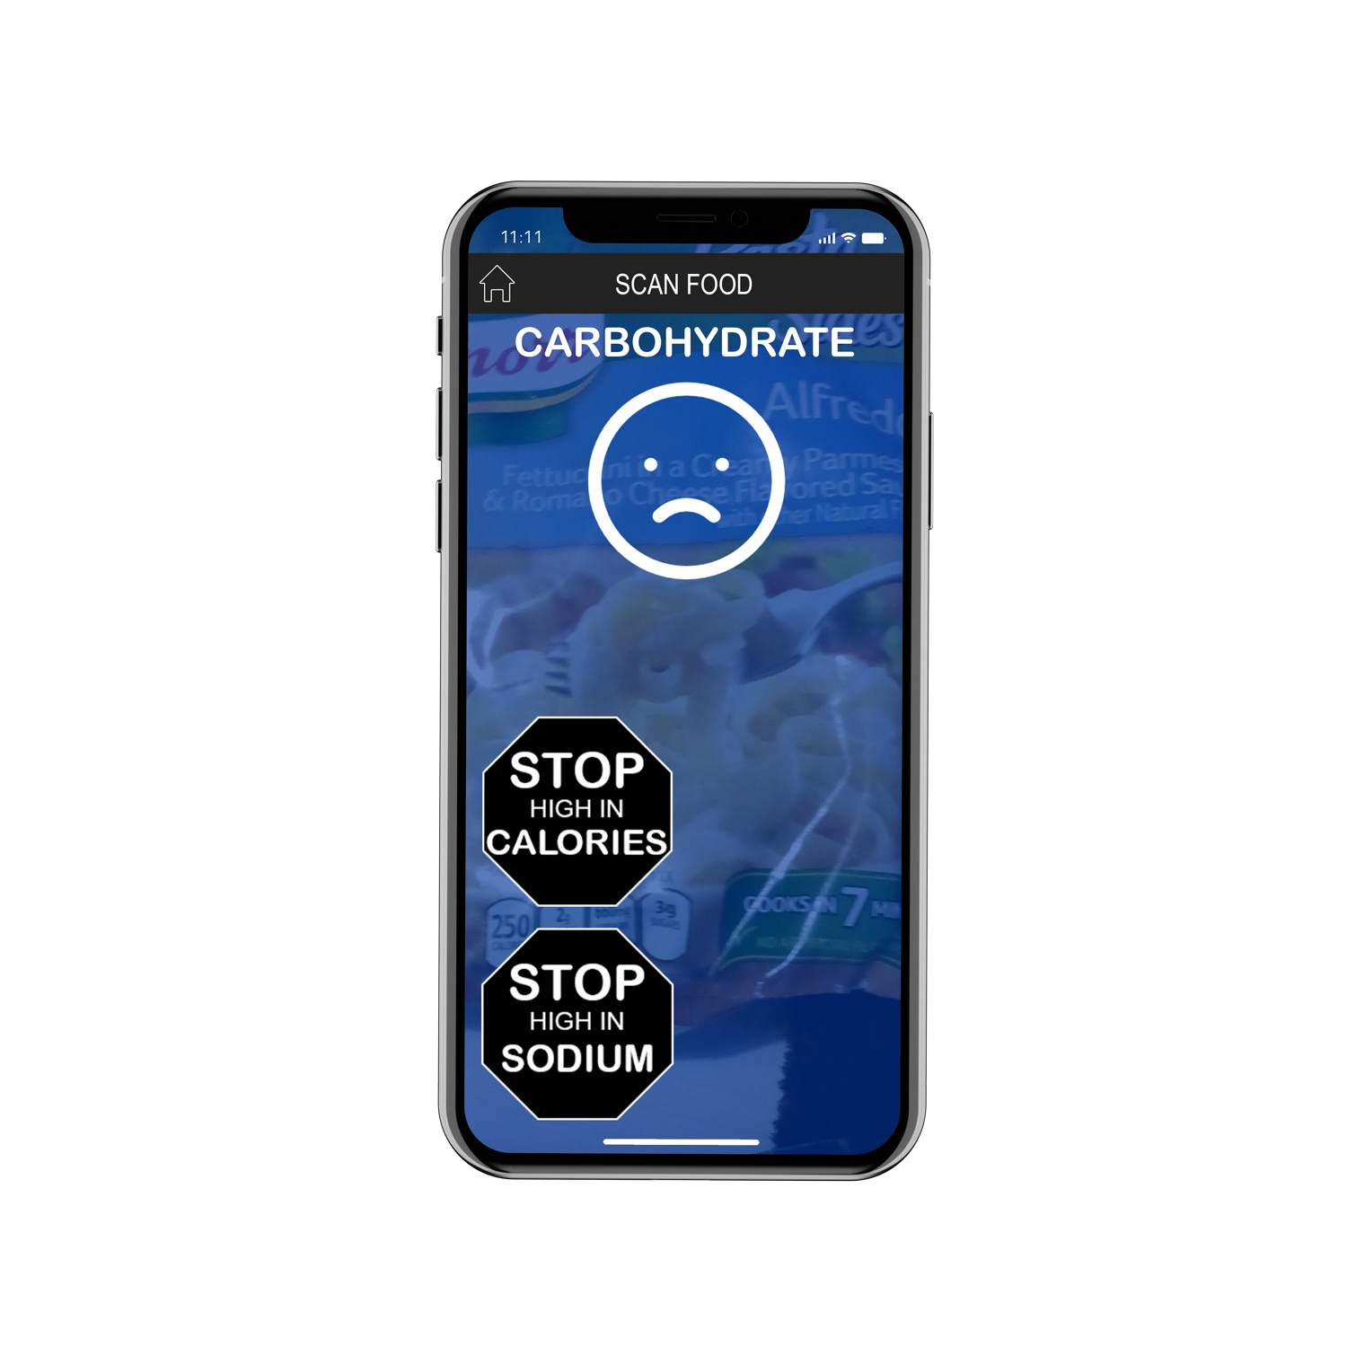
Childhood OBESITY IN AMERICA
FOOD FILTER PROJECT
How does Food Filter work?
Here’s an example of a frozen Alfredo-style pasta item.

Slide 25
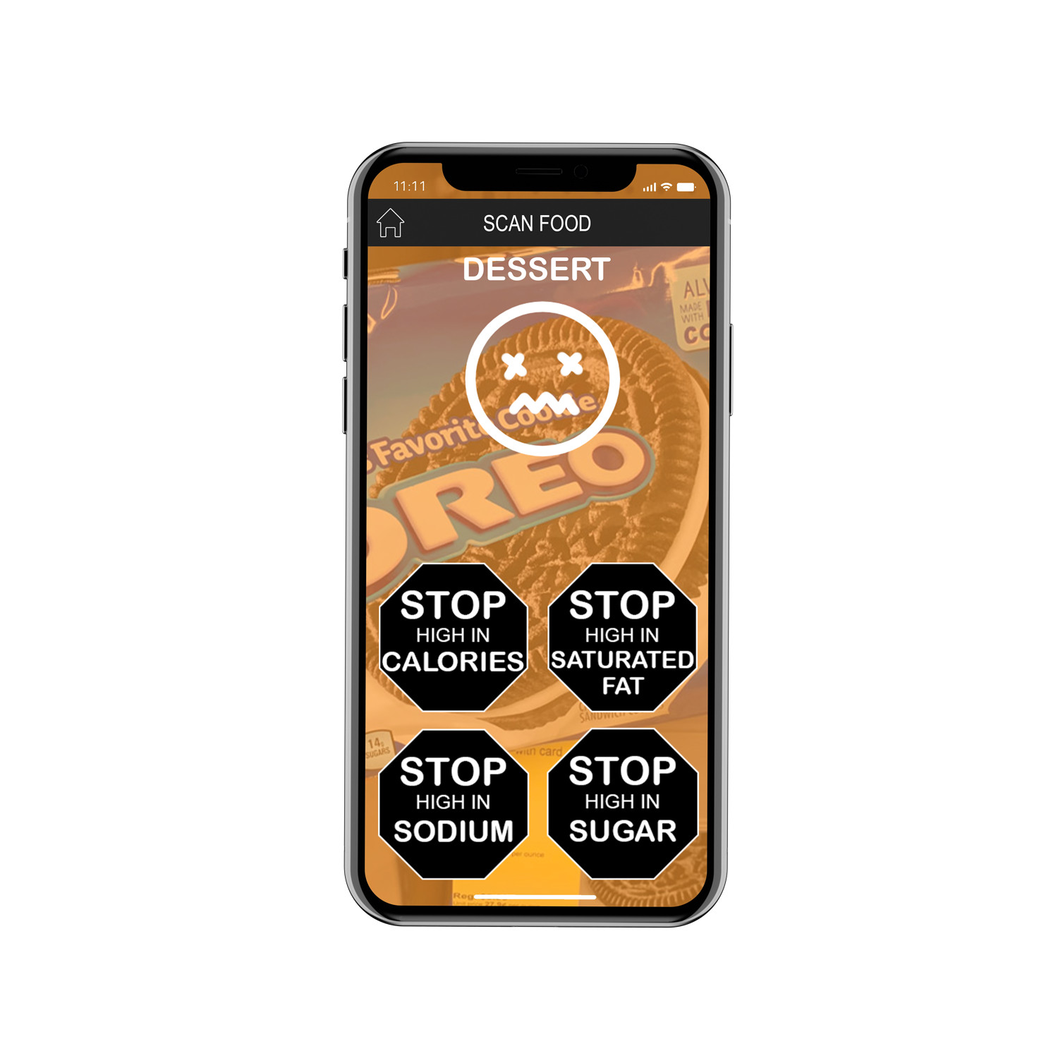
Childhood OBESITY IN AMERICA
FOOD FILTER PROJECT
How does Food Filter work?
And, of course, DESSERT!

Slide 26
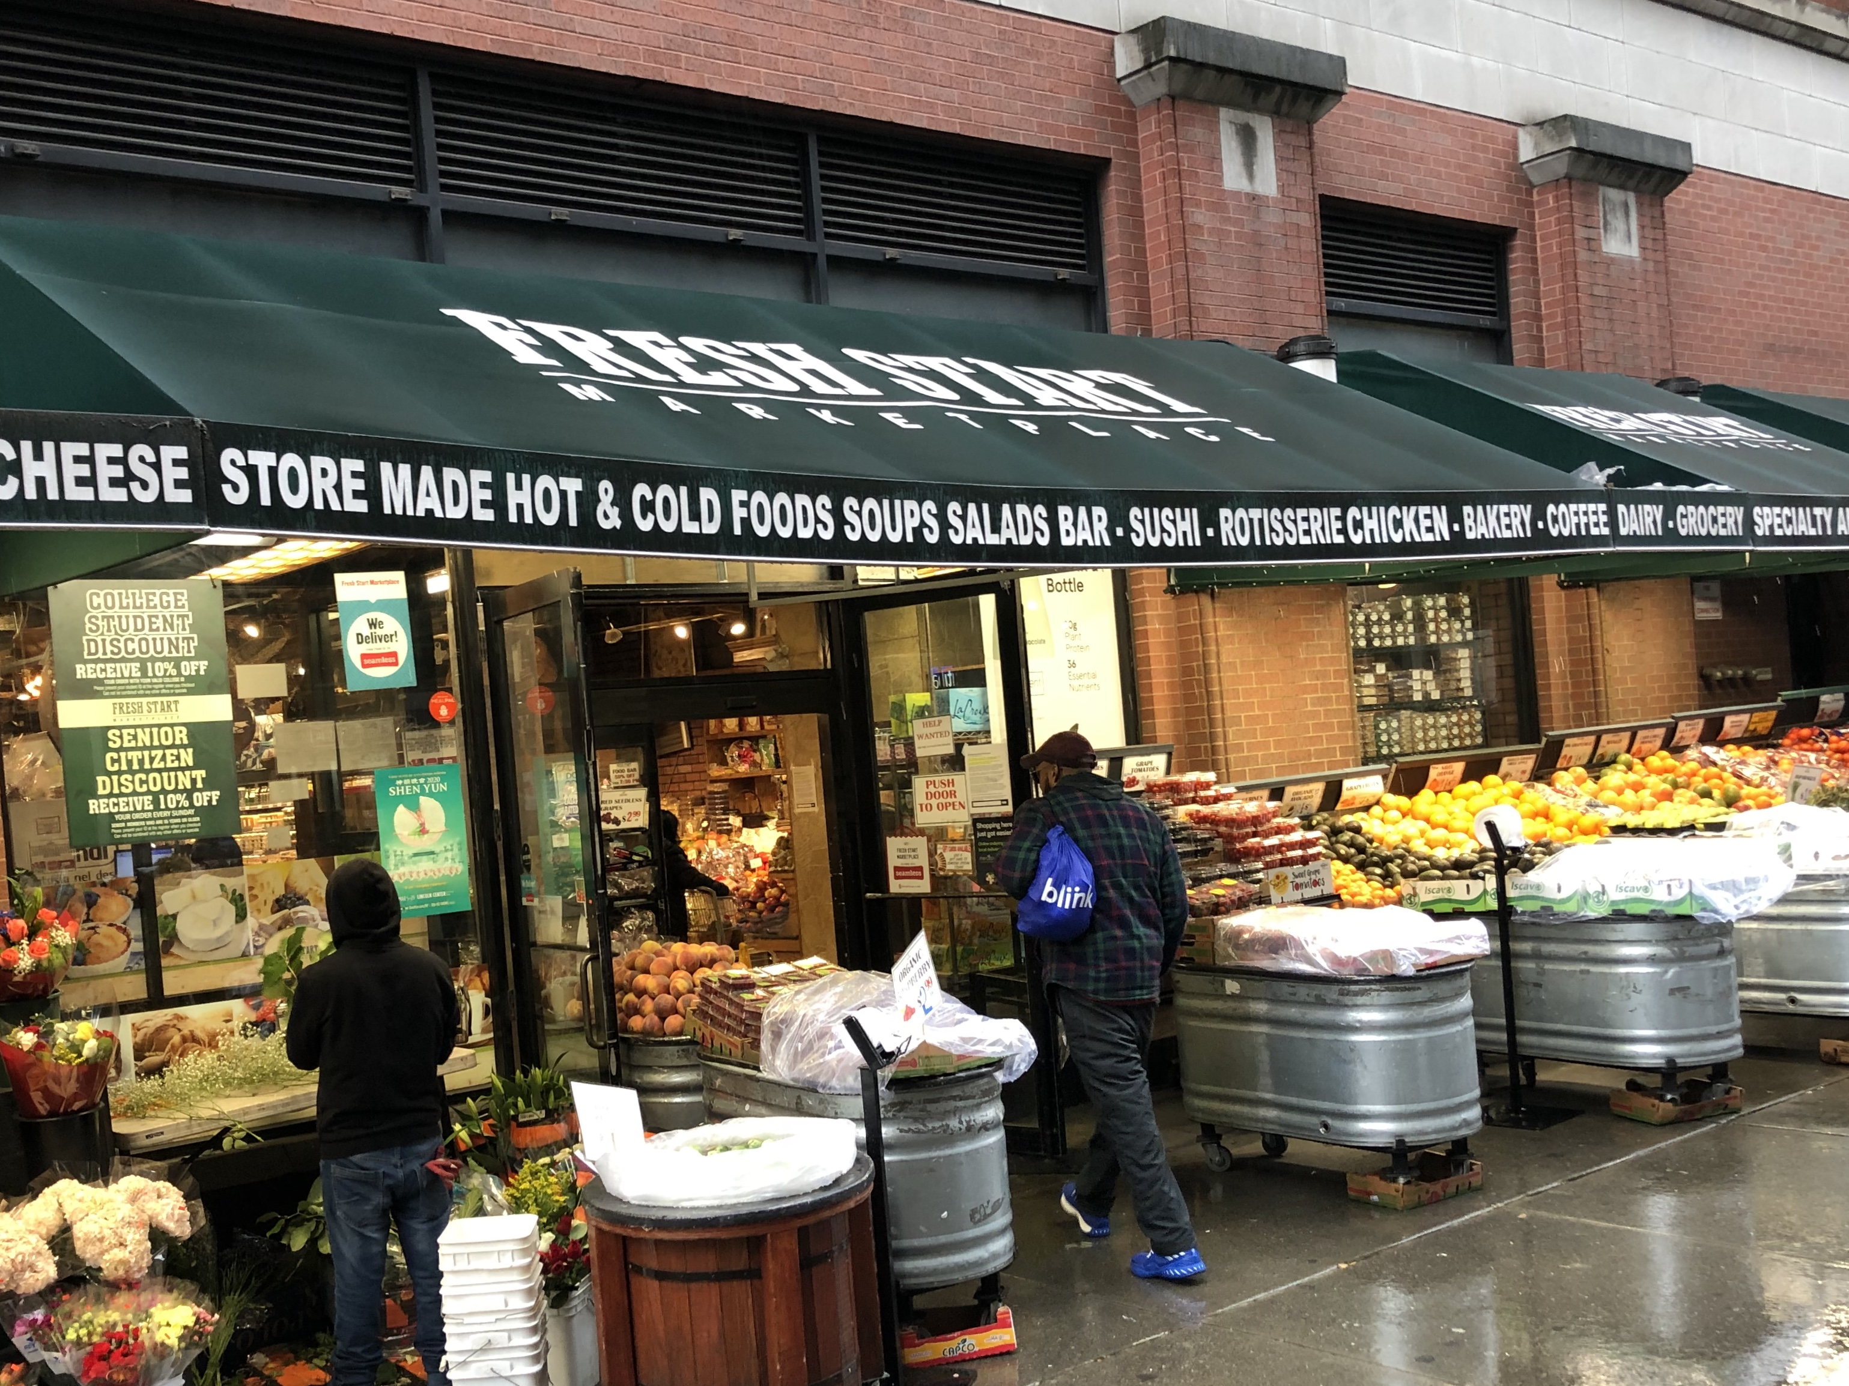
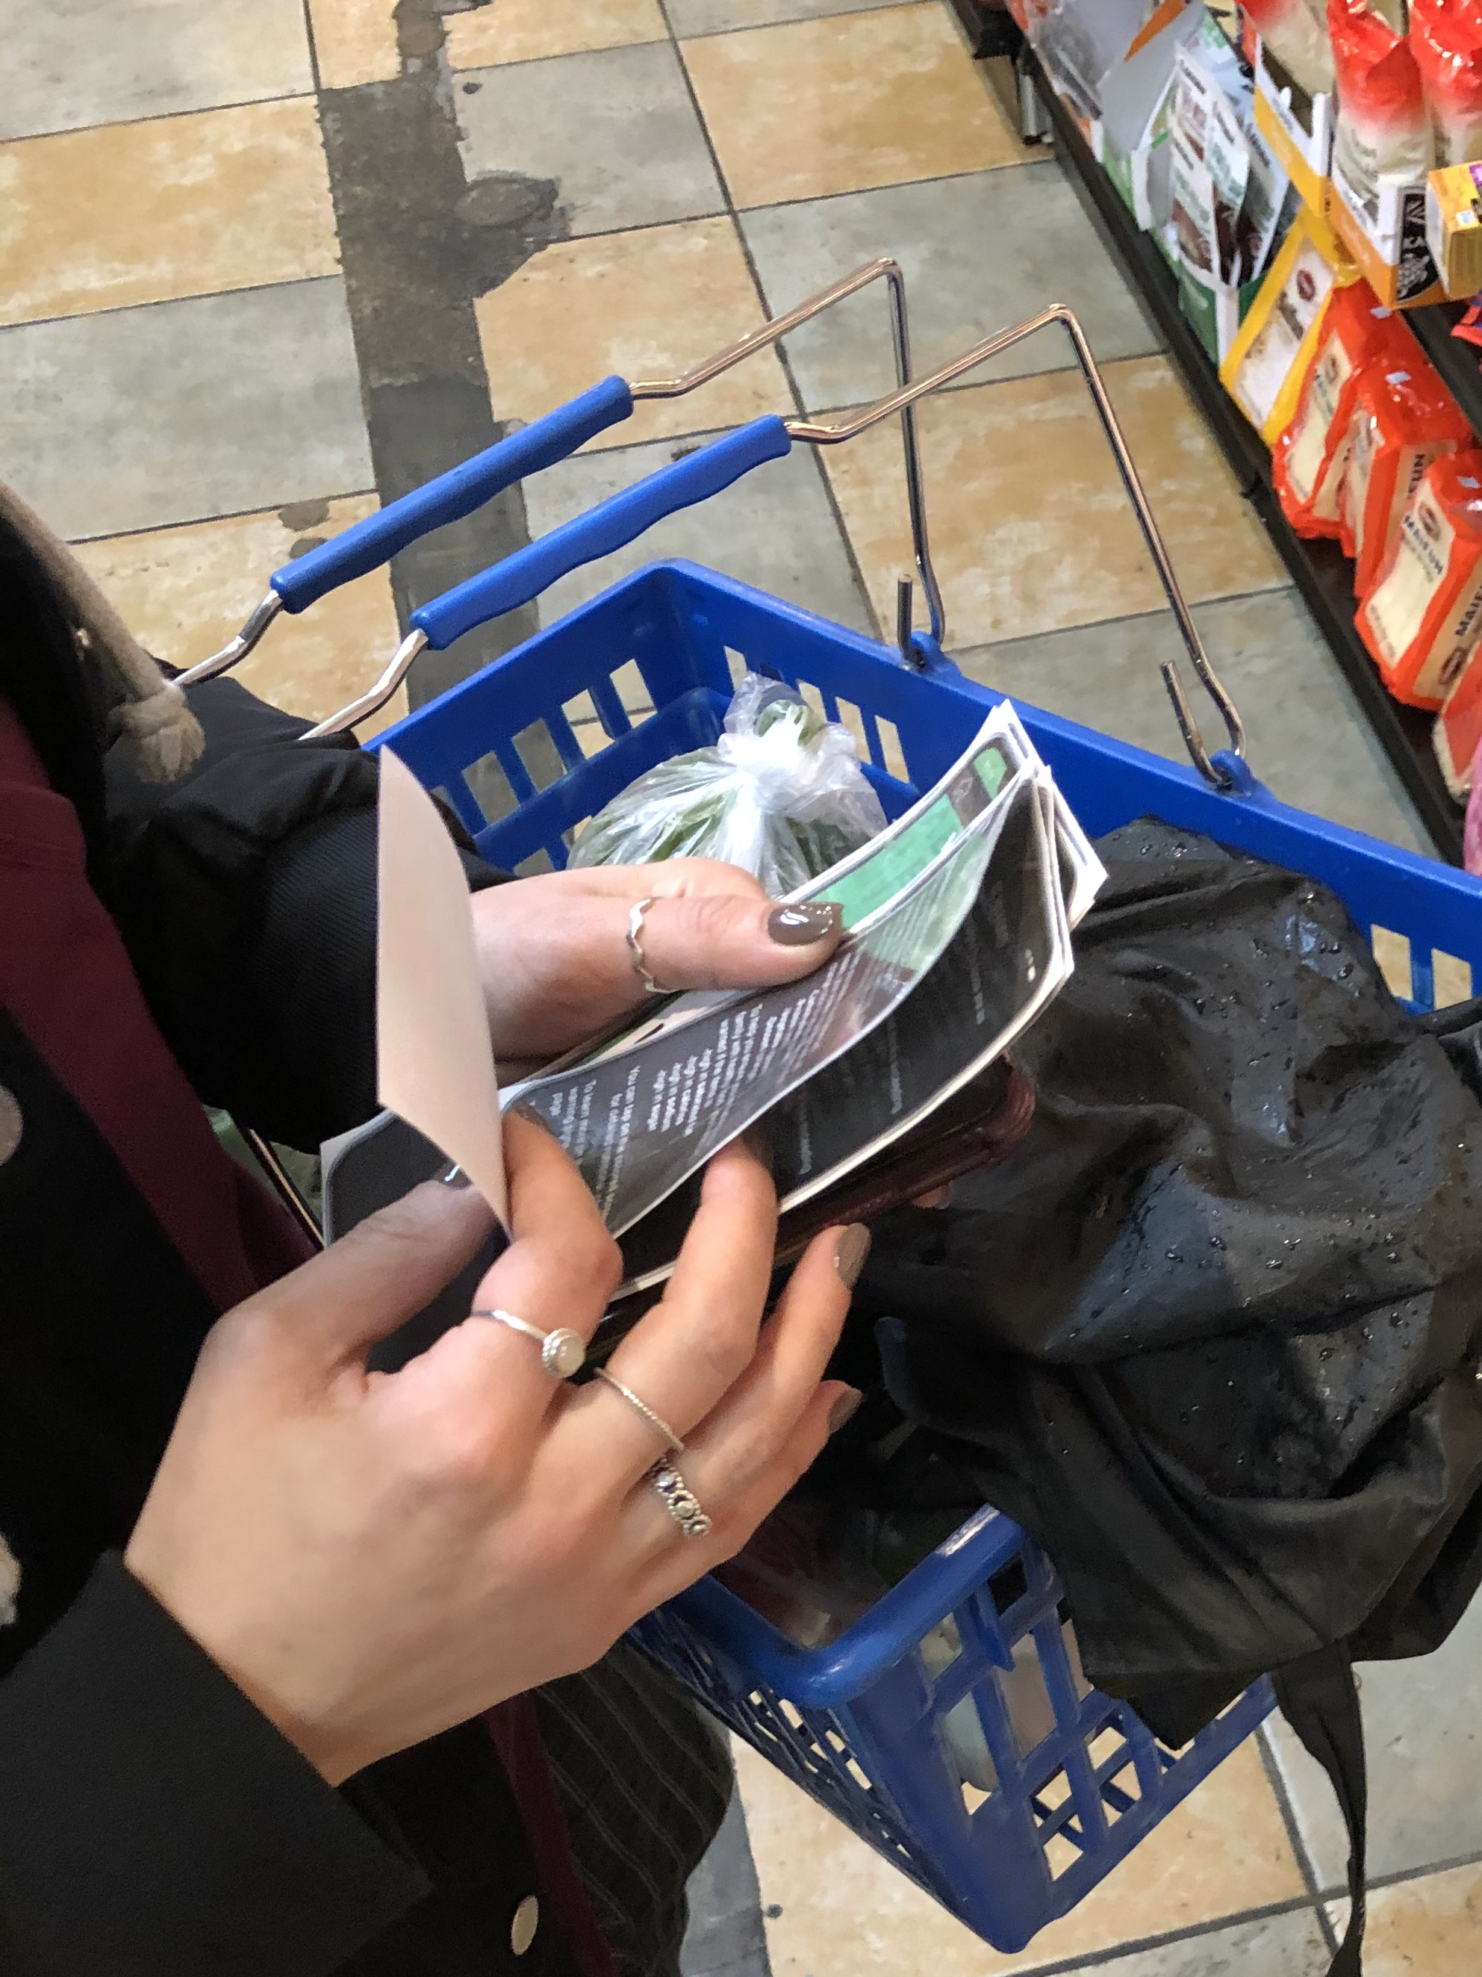
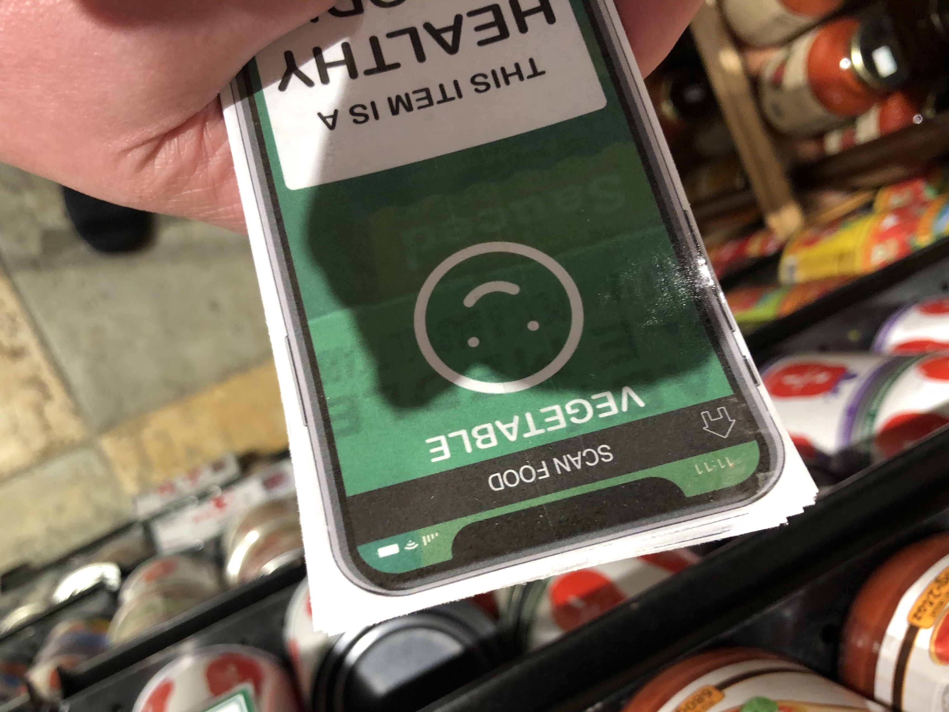
Childhood OBESITY IN AMERICA
USER TESTING
User Testing
I took a trip to a grocery store for some user testing with my prototypes.

Slide 27
Childhood OBESITY IN AMERICA
USER TESTING
User Testing Results
Here’s what I found:
All three* of the users responded very positively to the idea of the app and the prototypes; they all said that the instructions were clear and the app seemed surprisingly simple to use.
Two of the three said they had no comments on what could be improved.
One said that it wasn’t clear that you could tap on the screen and get the nutritional information about Calories, Sat Fat, Sugar, and Sodium—which I agree could be resolved with a ‘i’ (info) icon. She also said having all the nutritional info might be good, too.
*I was aiming for 5 user tests, but the store was on a busy street and most customers were in and out—which I attribute to only 3 of the 7 people I asked agreeing to do user testing.

Slide 28
Childhood OBESITY IN AMERICA
next steps
Future Opportunities
Expand Filter Options:
-Family food allergies
-FODMAP (IBS)
-Glycemic index
-Vegan
-Kosher/Halal
-MANY MORE
Ability to add products, should they not appear in our database, as well as to access a history of scans.
Use camera on one phone with app to allow another user to see the info (Think: People with mobility issues and their helpers)

Slide 29
Childhood OBESITY IN AMERICA
next steps
FOR NOW, THOUGH
Food Filter is designed to keep things clear and simple while helping parents better feed their families and fight childhood obesity…
and that’s what it does!

